Slide 1
SOLAR PERGOLAS
December 11,2023

Slide 2
SOLAR PERGOLAS
On June 2, 2023 the Texas Legislature passed into law House Bill 3526 which states that a municipality may not apply a municipal building code to the construction of a solar pergola.

Slide 3
What does that mean
This means that the City of Kerrville cannot apply codes or other municipal requirements to the construction of a solar pergola that are not currently adopted by the state of Texas.

Slide 4
What is a solar pergola
A solar pergola is a type of solar canopy structure consisting of columns holding up an open roof or grid of beams, rafters, or lattice work with an integrated solar energy system. A pergola shall not be used as a carport, a garage, or storage.

Slide 5
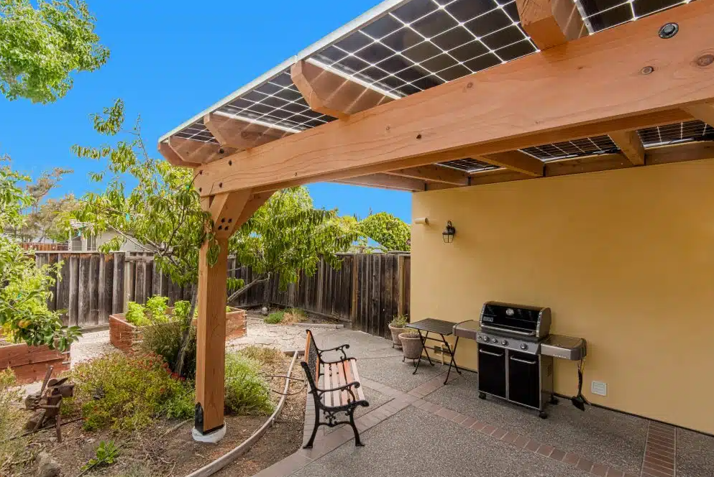
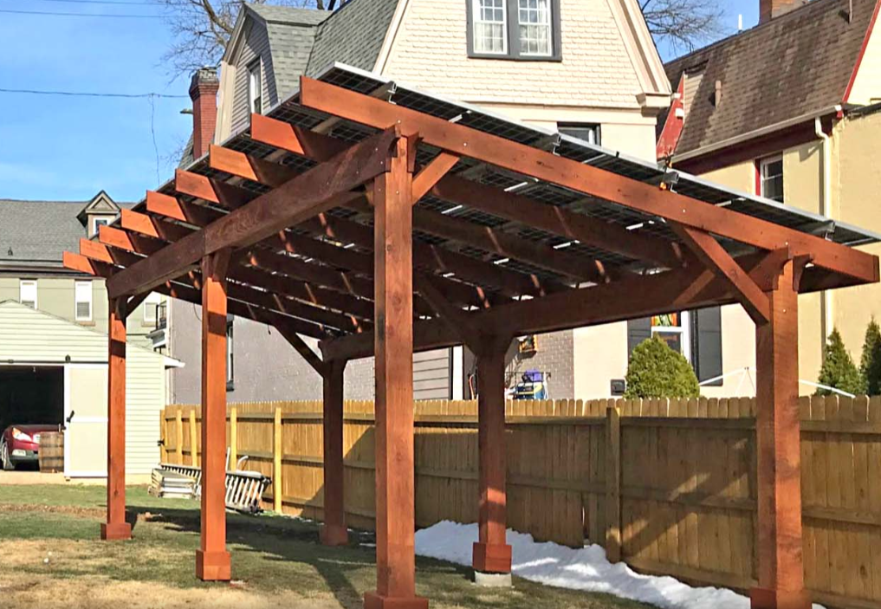
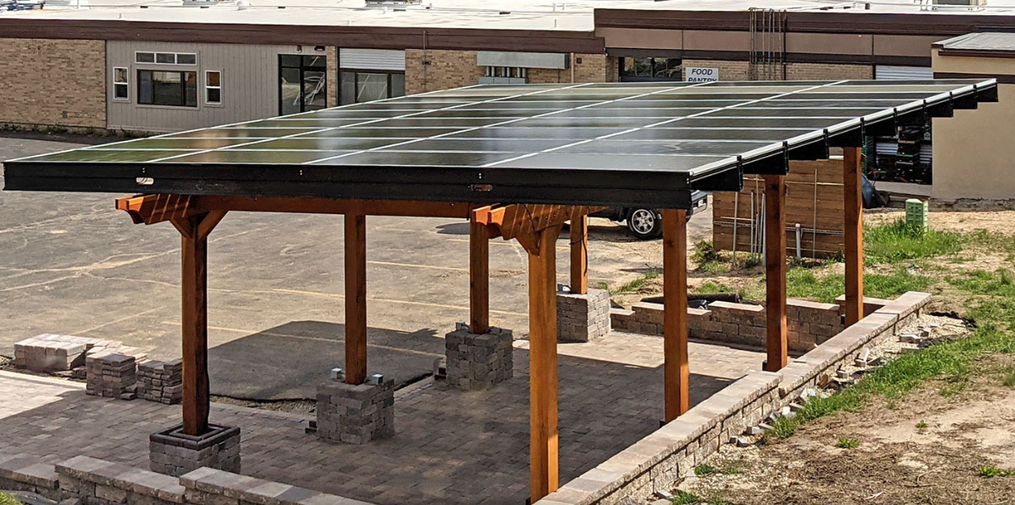

Slide 6
Do I need a Permit
Pergola structures supporting a mounted array system will require a permit in compliance with the State of Texas adopted 2012 International Building Code and the International Resident Code and the locally adopted codes for all other requirements.

Slide 7
What do I need to submit
Permitting documents
  Engineered plans for foundations and roof mounted PV systems for new installations.
  Structural letter for additional load from engineer for existing pergolas
  Electrical plans conforming to Article 690 of the 2017 NEC

Slide 8
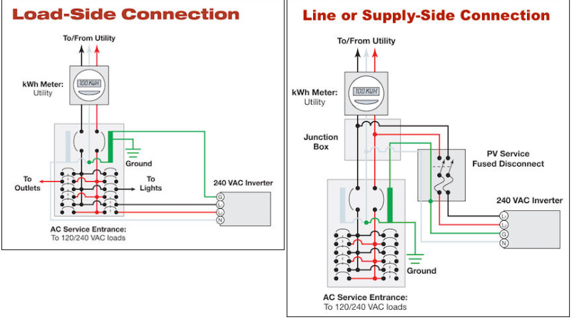

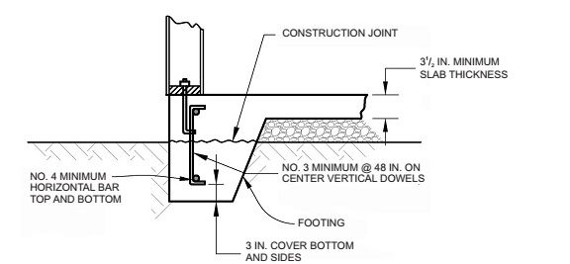
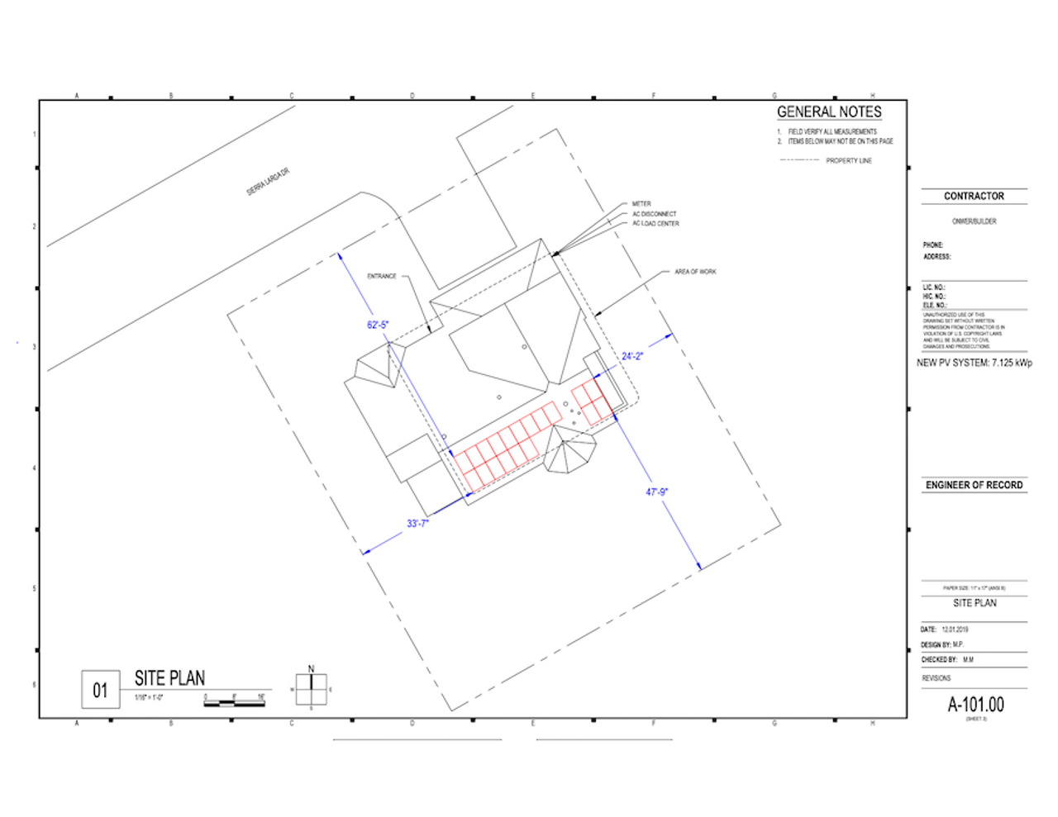

Slide 9
Where can I apply for a permit
Permits can be applied for at www.mygovernmentonline.org

Slide 10
Thank You

